Slide 1

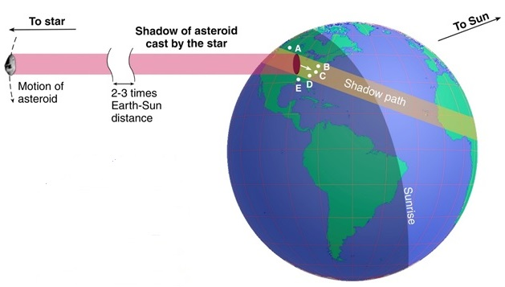
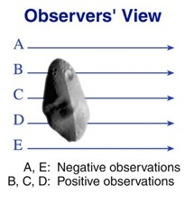
410.05 – Results of Observations of Occultations of Stars by Main-Belt and Trojan Asteroids, and the Promise of Gaia
David W. Dunham*, David Herald,
Steve Preston, Brian Loader, and Joan Dunham
*email david.dunham@kinetx.com Cell phone 301-526-5590
AAS Division of Planetary Sciences, Pasadena, Calif., 2016 Oct. 20
Sky Plane

Slide 2
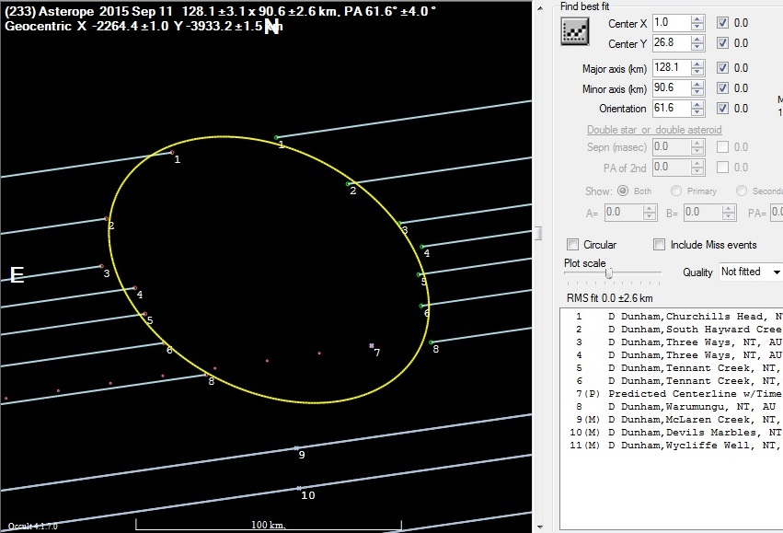
2015 Sept. 11, occultation of 9.2-mag. star by Asterope
With 7 chords recorded
across the length of the
asteroid, this was Joan’s
and my most successful effort ever to observe an asteroidal occultation, from sites near the Stewart Hwy north and south of Tennant Creek, Northern Ter., Australia.

Slide 3
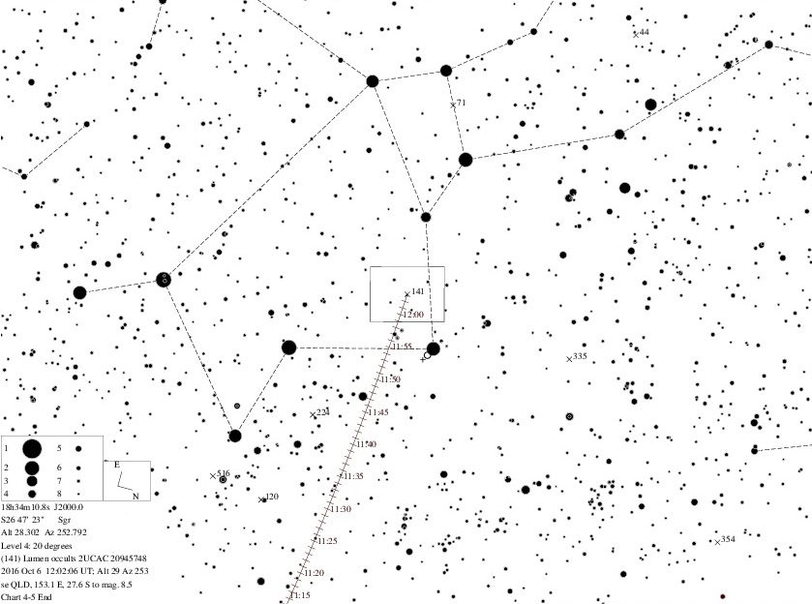
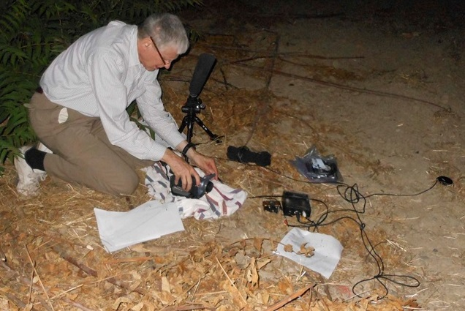
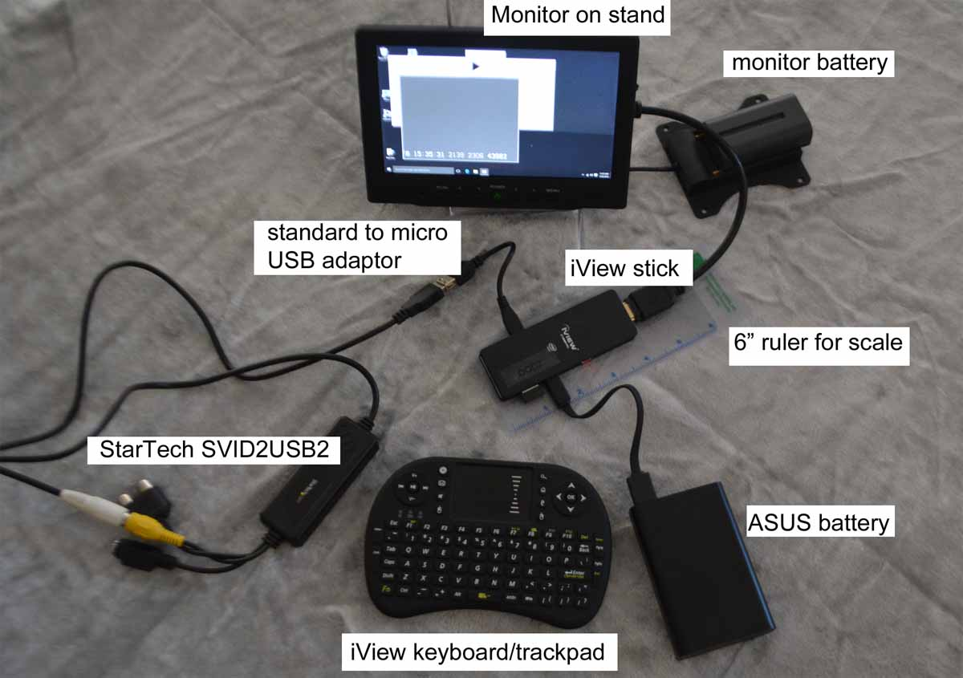
Multiple Station Deployments by Single (or Pairs of) Observers
One observer can pre-point multiple telescopes with video cameras across the predicted path, with recorders and timers to record the observations with equipment powered with small batteries, mainly 12-volt DC packs of common 8 AA batteries. The telescopes are stationary, pointed to the altitude and azimuth of the occultation using star charts.
Example of a pre-point chart
Setting up a “mighty mini” remote video station MiniPC for remote timed video recording

Slide 4
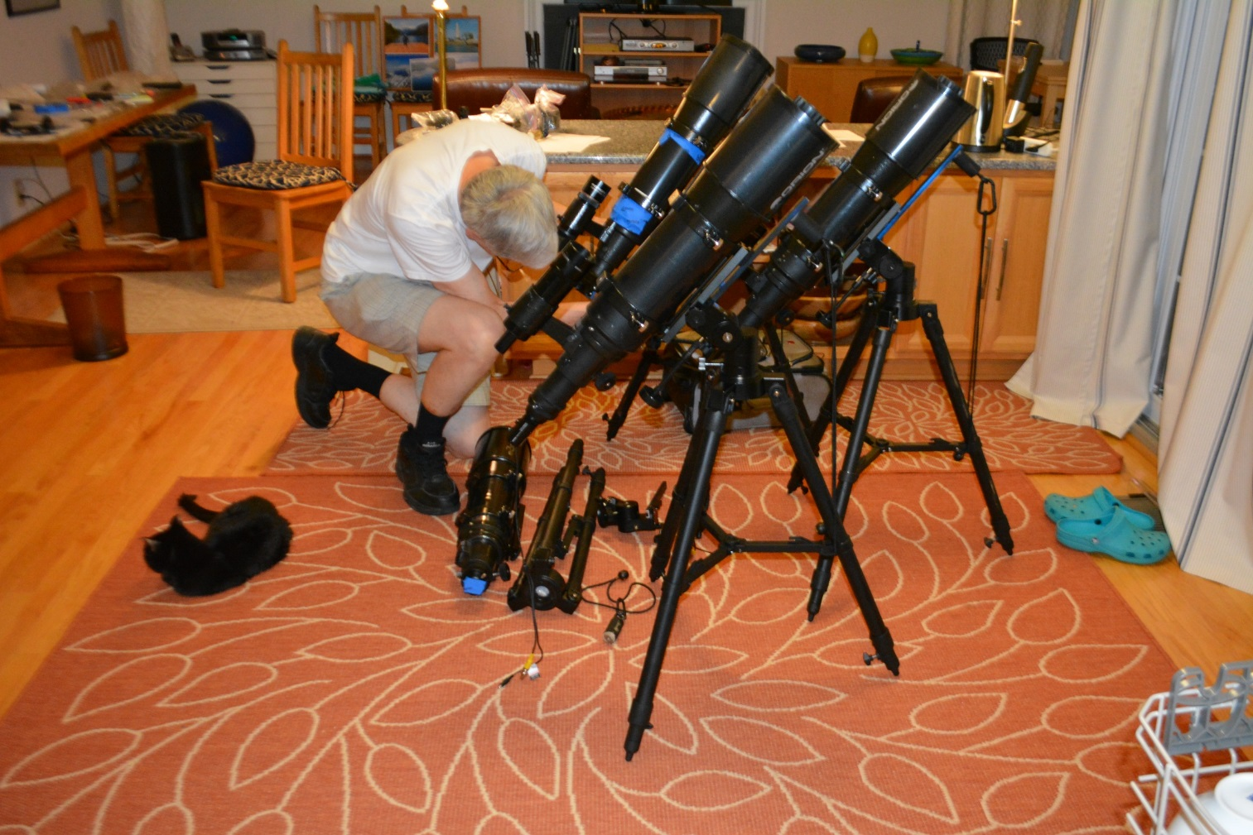
Mighty Maxi – Orion 120mm short tube
This can record occultations of stars to mag. 12.0, even mag. 12.5 under good conditions
this uses a visual finder scope and an alt-az tension mount that’s light-weight and doesn’t need a counter-weight, designed by IOTA member Ted Blank. Commercial mounts that can hold this weight cost hundreds of $, more than twice the $300 cost of the 120mm OTA.
In the photo below, 4 maxi systems are checked out before packing for an air trip to Missouri.
Not shown is a “midi”
system using an Orion
80mm short tube that
sells for about $120.
It can record events to
mag. 11.0 and a little
fainter. An OMX
photographic Tripod for
about $50 can be used
well enough for it.

Slide 5
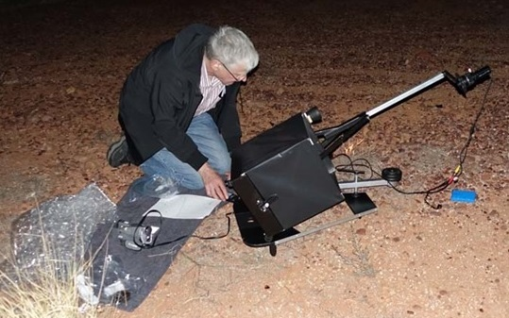
The 10-inch ‘Suitcase’ Telescope
The camera is at prime focus, so the images are reversed (one reflection); it is normally used for pre-pointed occultations of faint stars by asteroids (built by John Broughton).

Slide 6
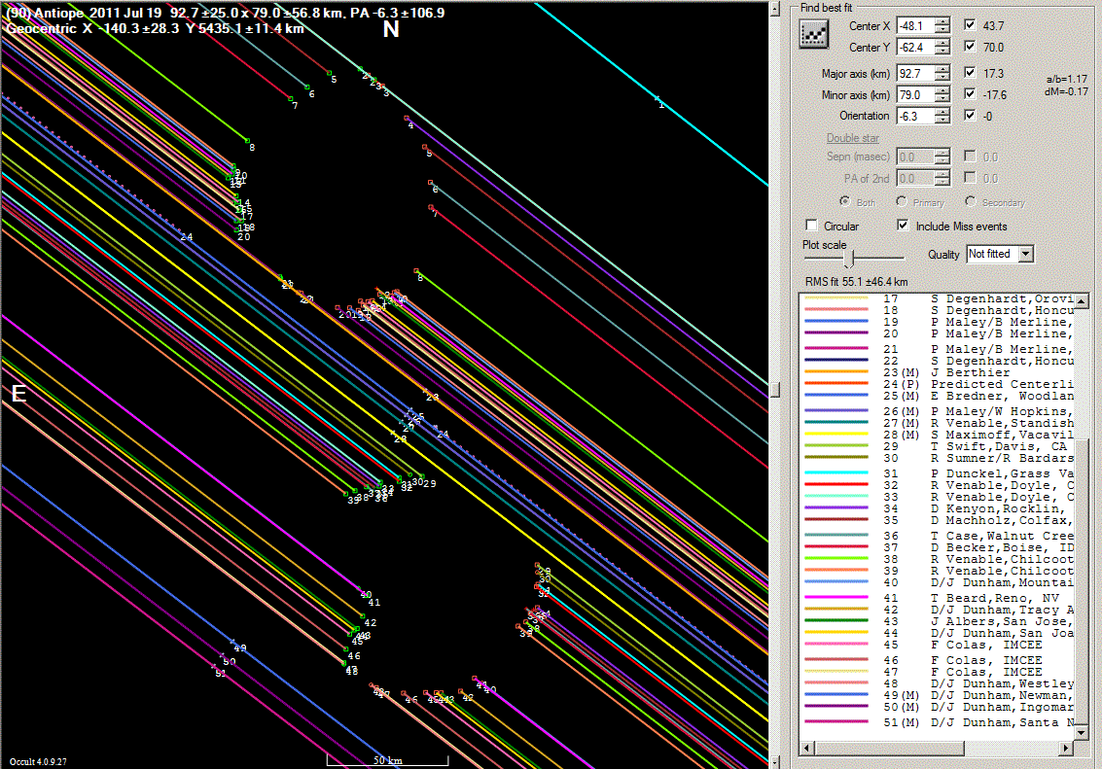

2011 July 19 occultation of LQ Aquarii by the binary asteroid (90) Antiope observed in western USA
Above is the best direct image of Antiope, by Bill Merline using AO with Keck
3d before the occultation; it allowed a good pre-diction of the objects’ orientation.

Slide 7
2015 April 2 occultation of 10.7-magnitude
TYC 0283-00694-1 by (90) Antiope
This occultation, observed from California to Florida, resolved both components again, helped by the fact that the star was found to have a 12th-mag. companion about 0.05″ away (that is about 1.7 times the diameter of one of the components). Analysis by Josef Durech.

Slide 8
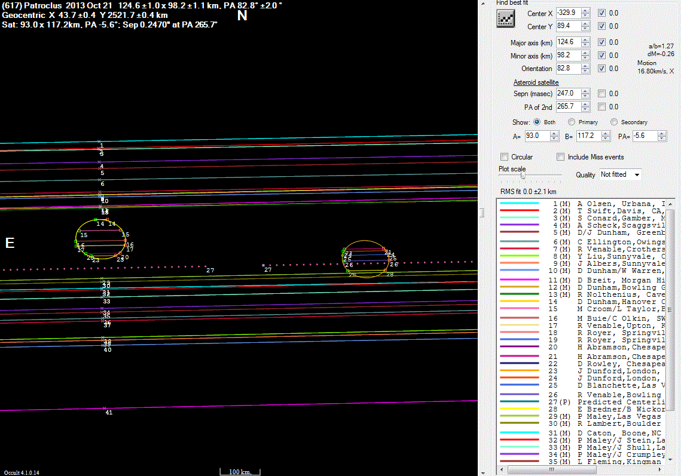
Trojan (617) Patroclus Sky Plane Plot

Slide 9
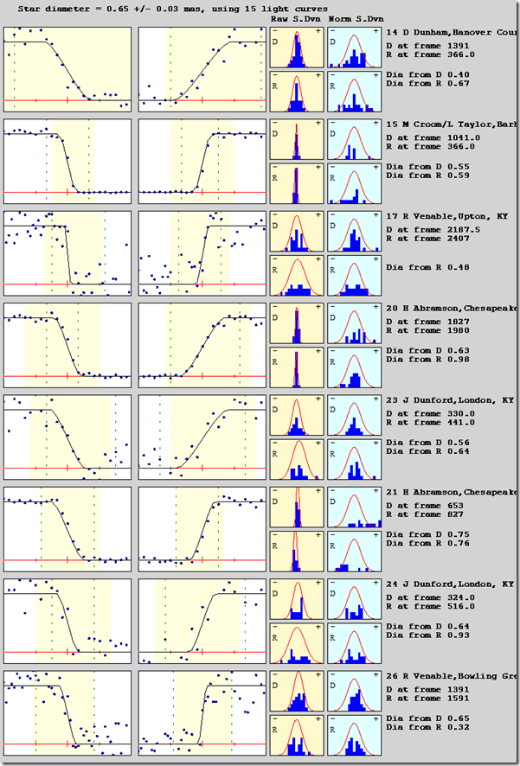
Dave Herald determined the 9.6-mag. spectral type M star’s angular diameter from the video occultation lightcurves at the right; Dunham’s station at Hanover Courthouse, VA near the Patroclus N. limit is at the top. The star is
TYC 0646-00730-1

Slide 10
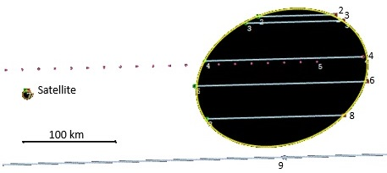
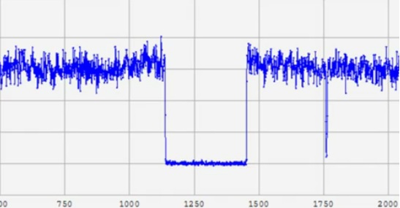
Sky-plane plot, 2012 Jan. 19th
(911) Agamemnon [Trojan] occultation
Below:
Light curve by Steve Conard (sta. 6) using a 14-in. SCT at his observatory at Gamber, Maryland
Above:
Agamemnon: Axes 190.6 ±0.9 by 143.8 ±1.5 km, PA minor axis -69.3° ±1.3°, center X 4661.6 ±0.4 km, Y 3113.7 ±0.6 km; Disappearances are on the right side. The probable satellite is plotted as 9-km circle (but it’s more likely about 4 km across) 0.0931″ (278 km in the plane) from Agamemnon’s center in PA 93.8°

Slide 11
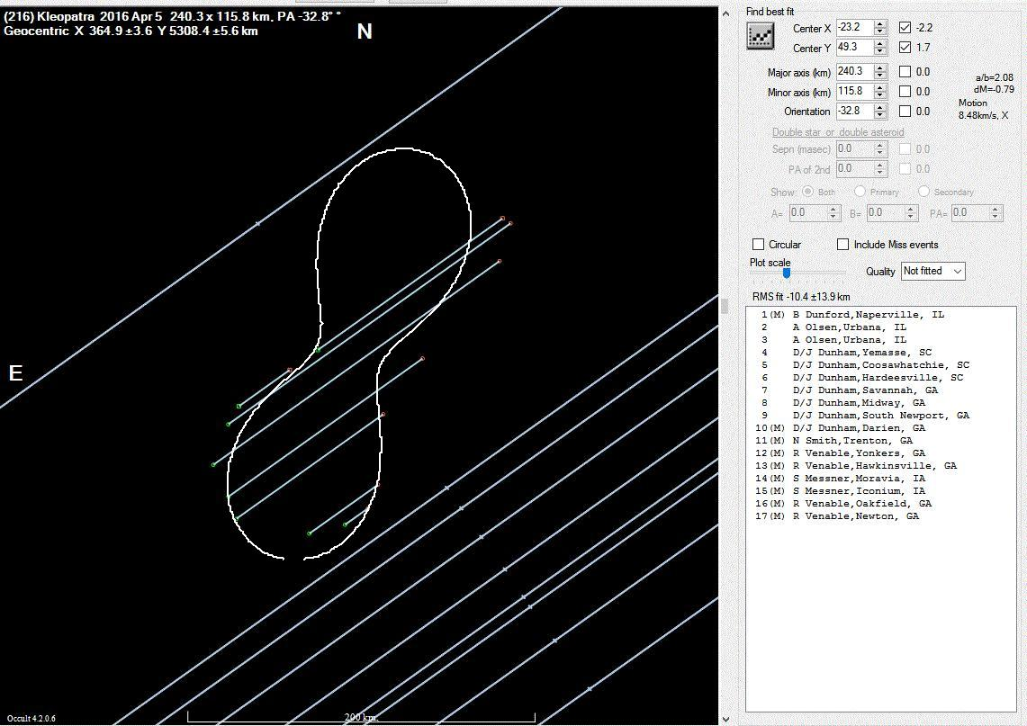
(216) Kleopatra 2016 April 5 Descamps Model Fit
We look forward to Gaia data to improve the path predictions!

Slide 12
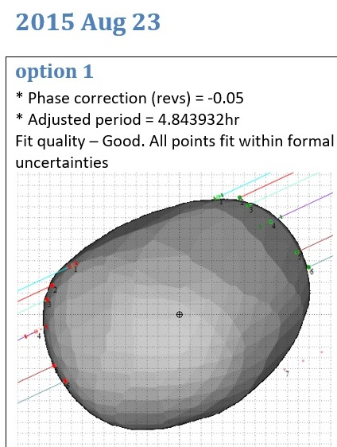
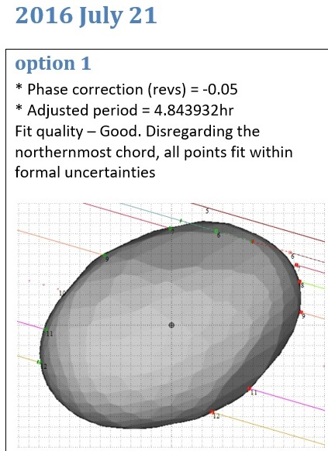
(107) Camilla, Correcting its Rotation Period
For these two events, the 1st option (with a period of 4.843932hr) results in a good fit to both occultation events. This is a correction of +0.000004hr (0.014sec) to the DAMIT period. Analysis by Dave Herald.

Slide 13
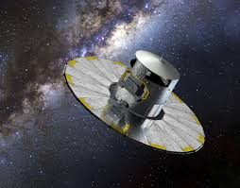
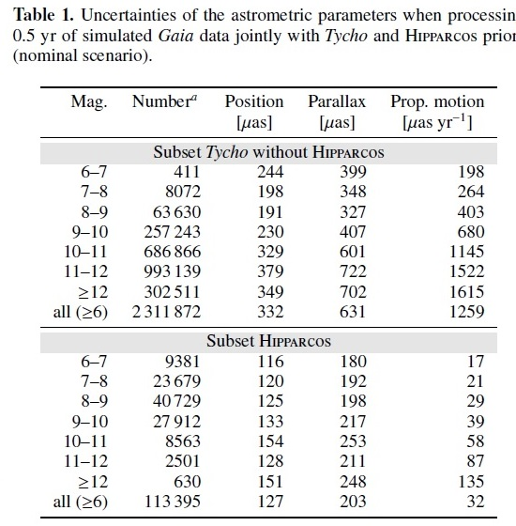
Gaia First Release Star Catalog
September 14, 2016
IOTA quickly replaced the stellar data for its predictions with TGAS data when available, and for other stars, now uses a “Gaia14” catalog of stars to mag. 14.0 using UCAC4 positions at the UCAC4 epoch and Gaia DR1 positions to generate proper motions.

Slide 14
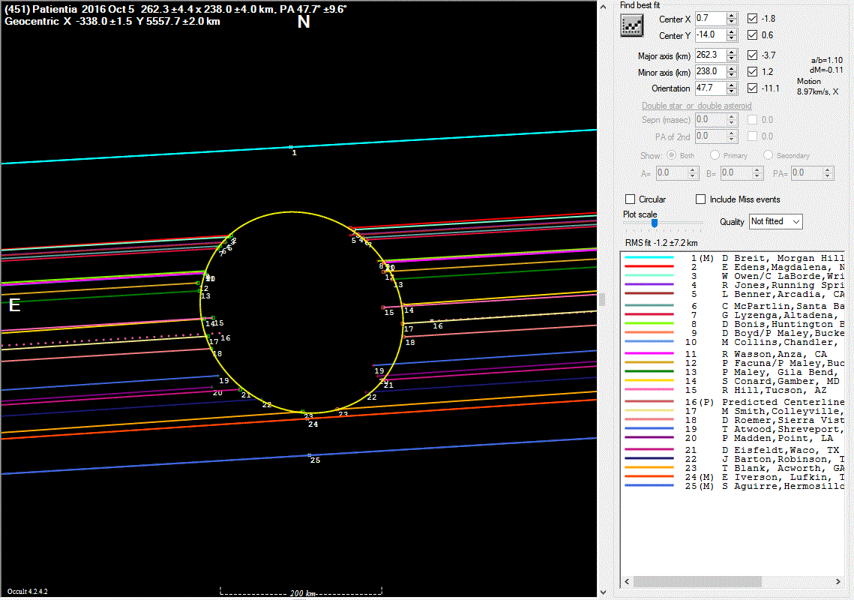
2016 Oct. 5 (451) Patientia Occ’n over southern USA
We look forward to Gaia data to improve the path predictions!
For this first good post-Gaia-DR1 prediction, the path shifted about 0.1 path-width north since the asteroid ephemeris was not accurately linked to the Gaia frame. The prediction for an occultation by (141) Lumen seen in Queensland on Oct. 6 was better.

Slide 15
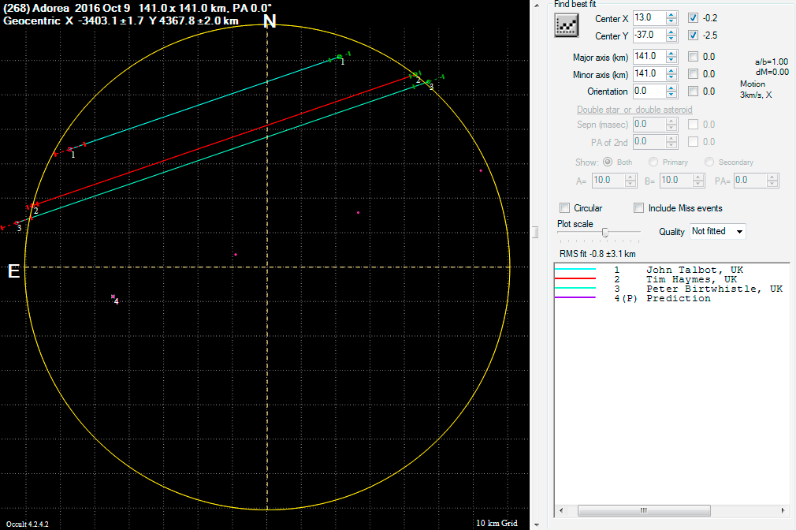
2016 Oct. 9 (268) Adorea Occ’n observed in England
This occultation of a 12th-mag. star occurred 4 days before an occ’n of Regulus was to occur in n. Papua New Guinea.
We look forward to Gaia data to improve the path predictions!
It gave confidence in the prediction for the brightest asteroidal occultation of 2016. Analysis by Eric Frappa using Steve Preston’s Adorea ephemeris & Gaia14 stellar data.

Slide 16
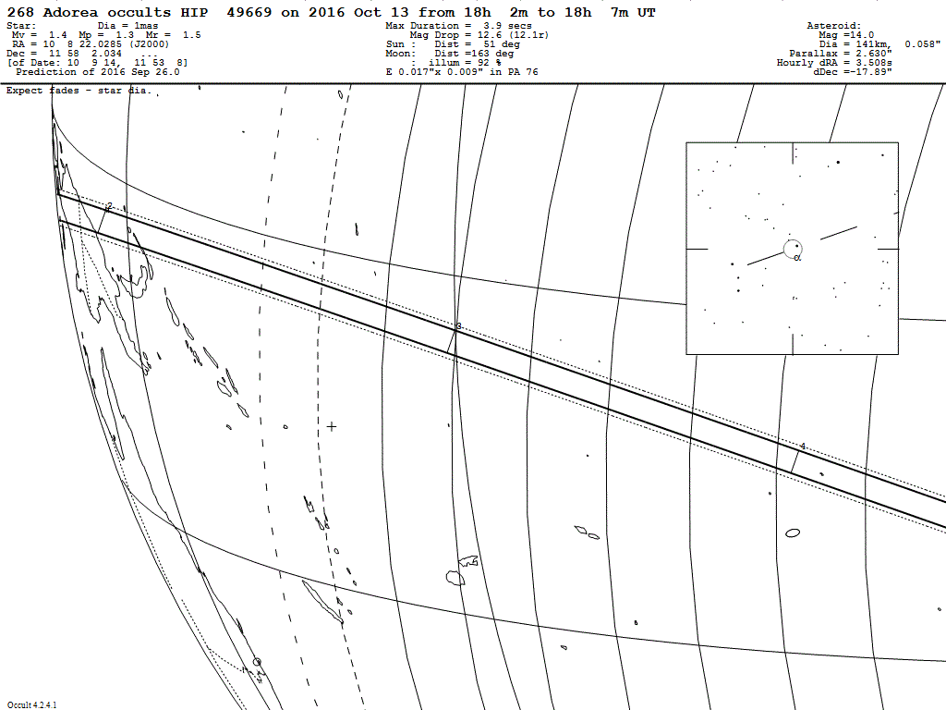
←
Sunrise Line
Joan and I traveled to Kavieng, at the north
end of New Ireland Island in n.e. Papua New
Guinea, to try to observe this occultation of
Regulus, the 20th brightest star, by the large
asteroid (268) Adorea. Regulus has a close
companion discovered spectroscopically in
2005 that we wanted to record.

Slide 17
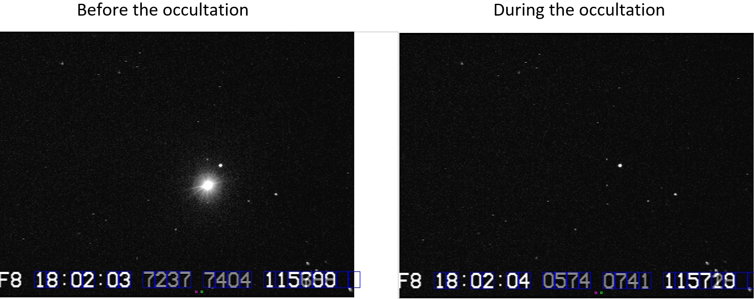
2016 Oct. 13 (268) Adorea Occ’n observed in P.N.G.
Regulus →
companion→
Our location was on the Pacific shore, at the north end of the Ulul Cocoa Plantation about 22 km s.e. of Kavieng. We used a 10-in. f/4 “Suitcase” telescope and 4-frame integration with a Watec 120N+ camera. Comparison with field stars shows that the companion is 12th mag., consistent with it being a white dwarf. The companion was not occulted during the 3.8s occultation. Adorea was 14th mag. at the time. Regulus has a more distant (3′) 8th-mag. companion that you can see above and to the right. We wanted to run 5 stations, but skies were overcast until only 2 hours before the 4am (local time) event. UTC from 1PPS GPS is shown using an IOTA-Video Time Inserter.

Slide 18
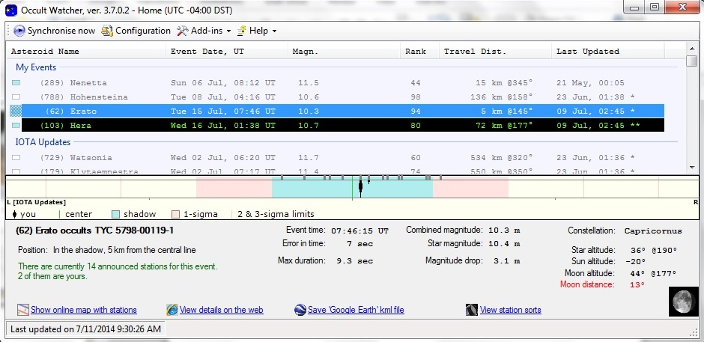
Occult Watcher Planning Tool
Used by observers to find potential occultations that they can observe, filtered by
distance (larger distances for mobile observers), star mag., etc., and give event details,
including links to star charts, etc. Through a Web interface, mobile observers can then
set up to fill gaps in coverage by those at fixed observatories. The free software can be
downloaded from http://www.occultwatcher.net/publish.htm .

Slide 19
Closing Comments
We encourage observatories to try to observe asteroidal occultations when they are predicted to occur at their location – the predictions are now more accurate with Gaia data. They provide educational and public outreach opportunities, and are complementary to RECON’s work with Trans-Neptunian Objects.
An important technique is the CCD drift scan technique, since many amateur and professional observers have CCD imagers for other purposes that can be used for occultations with exposures of a minute or two – see http://www.asteroidoccultation.com/observations/DriftScan/Index.htm
All asteroidal occultation observations collected by the International Occultation Timing Association are archived at NASA’s Planetary Data System’s Small Bodies Node at http://sbn.psi.edu/pds/resource/occ.html .
For more, see the information on planetary occultations in the annual Handbook of the Royal Astronomical Society of Canada and visit IOTA’s Website at www.occultations.org .

